Slide 1


Minor Project
Title: Uni Clean , Campus Sanitation Software
Presented by -
R2142211317 - Akshat Sharma R2142211365 - Atulya Verma R2142211292 - Kushagra Parasramka R2142211224 - Ronit Khurana
Mentored By -
Dr. Virender Kadyan

Slide 2
Problem Statement
In today’s university campuses, the maintenance of sanitation and cleanliness poses a significant challenge. As the student population continues to grow, traditional methods of ensuring a pristine environment struggle to keep pace. The lack of an efficient and transparent system for addressing sanitation issue further exacerbates the problem. Existing protocols often rely on manual reporting, leading to delays in response time and a disconnect between the students and the maintenance staff.
In addition to the existing challenges of maintaining cleanliness on the campuses, a critical concern lies in ensuring equitable distribution of workload among the maintenance staff. The current absence of a systematic approach for task allocation often results in disparities in the effort exerted by individual workers.
To address these issues , our project , UniClean, introduces a pioneering system for the fair and efficient assignment of tasks and also foster a cleaner, healthier, and more conducive atmosphere for learning and communal living.

Slide 3
Objective
Develop a user friendly software system that allows students to easily request cleaning services and workers to efficiently manage and complete cleaning tasks.
Create a system for the automated allocation of cleaning tasks to available workers based on their workload and location.
Enhance the experience of students by allowing them to submit and track cleaning requests conveniently through a digital platform.
Optimise worker management by tracking worker performance , workload and job history to ensure timely task completion.
Improve the overall cleanliness and hygiene of the campus environment.

Slide 4
SWOT Analysis
Strength
Weakness
Opportunity
Threat
Increased staff accountability.
Efficient and effective job allocation.
Potential resistance to adaptation of software.
False requests and false request completion confirmation.
Expanding system to other institutions.
Integrating AIML features to analyse patterns in locations.
Inappropriate and excessive requests.
Vulnerability to data breaches.

Slide 5
Deliverables of each step
Our project can be broadly divided into 5 phases, namely -
Project Initiation
Coding Round(I)
Coding Round (II)
Coding Round (III)
Testing and Fixing Bug
Project Initiation → Defined the project scope , workflow and project plan.
Coding Round(I) → Developed the initial authentication system and account management system.
Coding Round(II) → Developed the task allocation feature.
Coding Round(III) → Develop the UI for the software
Testing and Fixing Bug → Test and fix the bugs.

Slide 6
Methodology : Reference Software Model
Defining objectives and scope
Plan architecture and database structure.
Implement software modules.
Testing and quality assurance.
Deployment and maintenance.

Slide 7
Methodology : Timeline
Project Initiation
Decide project goal, scope and objective
Initialise project plan
Coding (Second Round)
Develop task allocation module.
Develop allocation algorithm.
Testing and Bug Fixing
Testing for bugs.
Fixing bugs
Final SRS
Sept 25 - Oct 5
Nov 7 - Nov End
Aug - Sept 20
Oct 18 - Nov 5
Dec
Coding (First Round)
Develop authentication system.
Develop account management system.
Coding (Third Round)
Creating UI for the software
Integrating all modules.

Slide 8
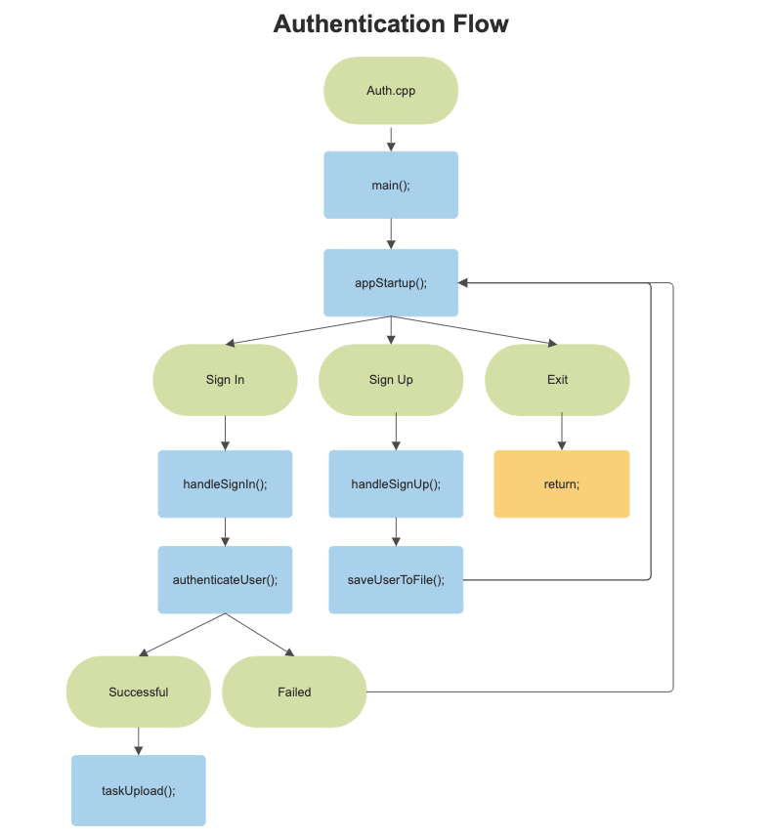
Technical Diagrams
Technical flow of user authentication feature

Slide 9
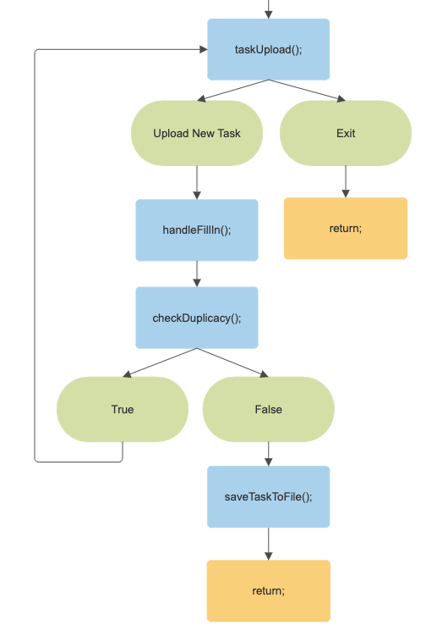
Technical Diagrams
Technical flow of user authentication feature

Slide 10
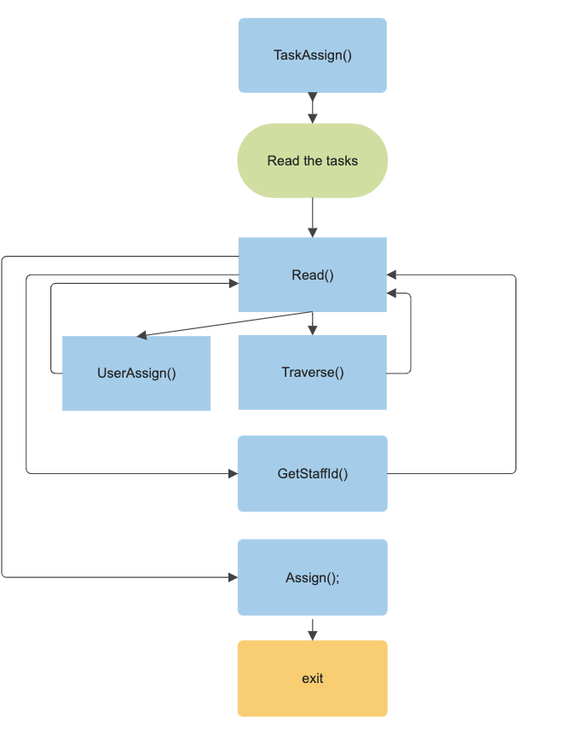
Technical Diagrams
Technical flow of task allocation feature

Slide 11
Attained Deliverable
Conducted thorough analysis or project and user requirements.
Created flow charts to depict the workflow of the project.
Developed the user authentication feature in the first coding phase.
Developed the task allocation feature in the second coding phase.

Slide 12
Working Model
SRS:
https://docs.google.com/document/d/14xfxouAt8uT1r_5MTo6MaODVE3IKMZpoGtOncugmFK0/edit?usp=sharing
GITHUB:
https://github.com/Akkkshattt-Sharrrmaaa/Uni-Clean

Slide 13
Reference: List of Cited Work
[1].Lalit Mohan Joshi. Article: A Research Paper on College Management System. International Journal of Computer Applications 122(11):32-44, July 2015
[2]Alt, Rainer and Auth, Gunnar (2010) "Campus Management System," Business & Information Systems Engineering: Vol. 2: Iss. 3, 187-190.
[3].Ashraful Kabir(2021). sanitation and hygiene practices among students in a public university,10.1371/journal.pone.0257663
[4].Kofi Baah-Bentum(2018).Improving Sanitation on Tertiary Education Campuses, 10.29322/IJSRP.8.12.2018.p8467

Slide 14
Thank You

